Slide 1
Project 2
Ames vacation house price
Here is how you get richer

Slide 2
AGENda
Introduction
eda
model
recommendations
Problem statement and purpose of this presentation
Which features matter and which do not
Which model was utilise
What to do next for your vacation house

Slide 3
01
Introduction

Slide 4

Problem statement
We are personal assistants to an ultrarich family. The head of the family (who shall not be named), has approached us to increase their vacation house value in Ames..

Slide 5
Purpose
Housing data from 2006 to 2010
Identify features to maximise value

Slide 6
Situation
Chaotic housing market in 2021
Demand of house > Supply of house

Slide 7
DATA set
Total number of features: 81
Nominal
01
02
ORDInal
Alley access
Misc features
House style
External Quality
External Conditions
Overall condition
Continuous
Discrete
Lot frontage
Sale prices
Square feets
Number of bathrooms
Number of fireplaces
Garage cars
03
04
Notes:
39 Numerical - 11 Discrete, 28 Continuous
42 Categorical - 14 Ordinal, 28 Nominal.

Slide 8
02
EDA

Slide 9
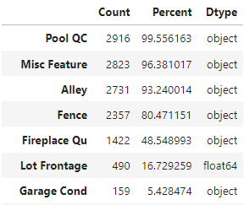
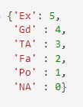

DATA TREATMENT
FILLING THE NULL
Impute with Mean, Mode, 0
27 Features
TREATING THE ORDINAL
With Ratings
- Quality
- Conditions
- Yes No
Feature Engineering
Combining the SQFT together
Create the age feature
Dropping COlumns
PID - Property ID
Notes:
To increase the data set reliabilities, we have to do data cleansing. The null has to be filled. Either with Mean, Median or Mode or with either 0 / NA

Slide 10
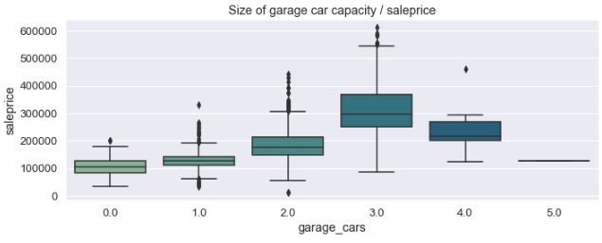
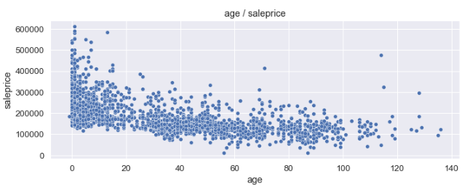
INTERESTING FACT
Notes:
House that hold 4 cars are cheaper than houses with 3 cars
The newer house have higher avg price, although that there are some houses more than 100 year old having higher price

Slide 11
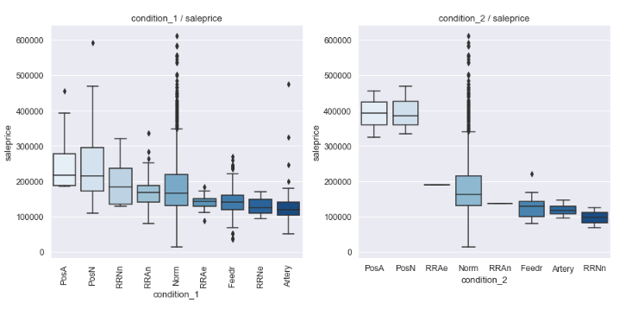
INTERESTING FACT
Notes:
Near positive off-site feature--park, greenbelt
Adjacent to positive off-site feature

Slide 12
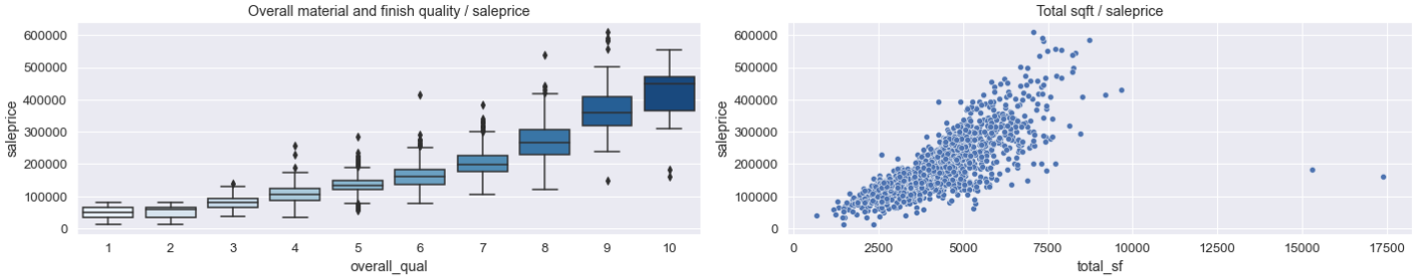
INTERESTING FACT
Notes:
The overall quality and Total SQFT are the two most important features. The two plots clearly shows that the better quality and bigger house make the house more expensive

Slide 13
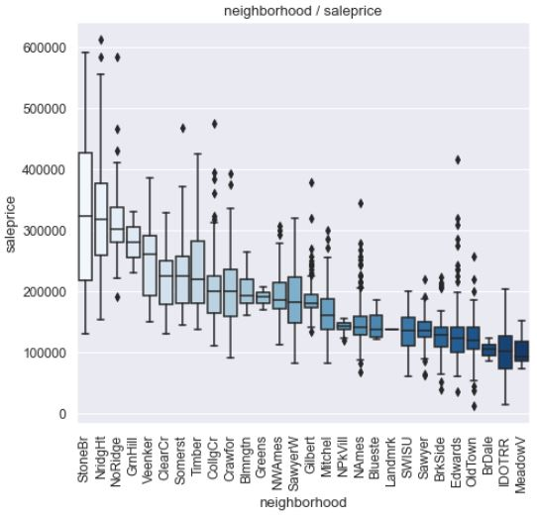
INTERESTING FACT
The Top 3 expensive neighbourhood price vs the Cheapest neighbourhood
Notes:
Median Price is 3 times more

Slide 14
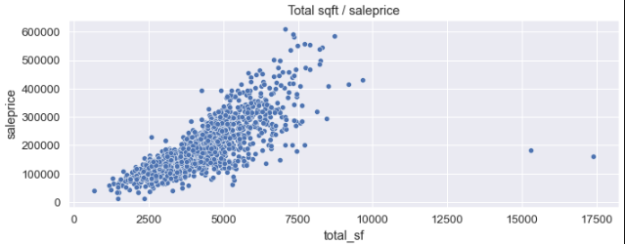
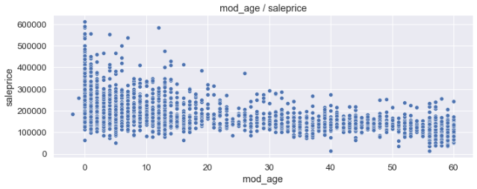
The outliers

Slide 15
Important Features
Overall MAterial Qual
Total SQ FT
Exterior quality
Garage car capacity
YEAR AGE

Slide 16
7,058 SQFT
$611,657
N_ridg_Ht
Total Living Area
The most expensive house
Town

Slide 17
03
Model

Slide 18
Model comparison
 | Linear regression | Ridge model | Lasso model
R2 Score Test | 0.883 | 0.87 | 0.91
R2 Score Train | 0.880 | 0.872 | 0.926
RMSE | 20471.61

Slide 19

LASSO MODEL
Based on the highest R2 score and lowest RMSE score

Slide 20
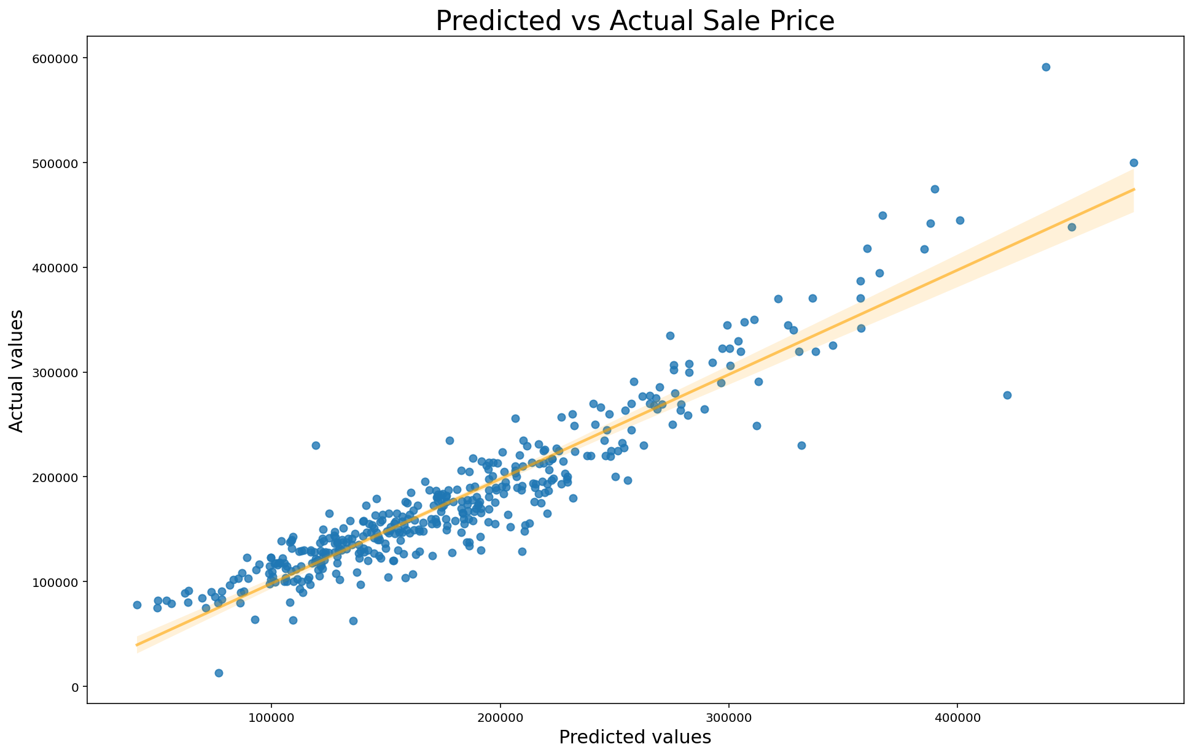
Predicted vs actual price

Slide 21
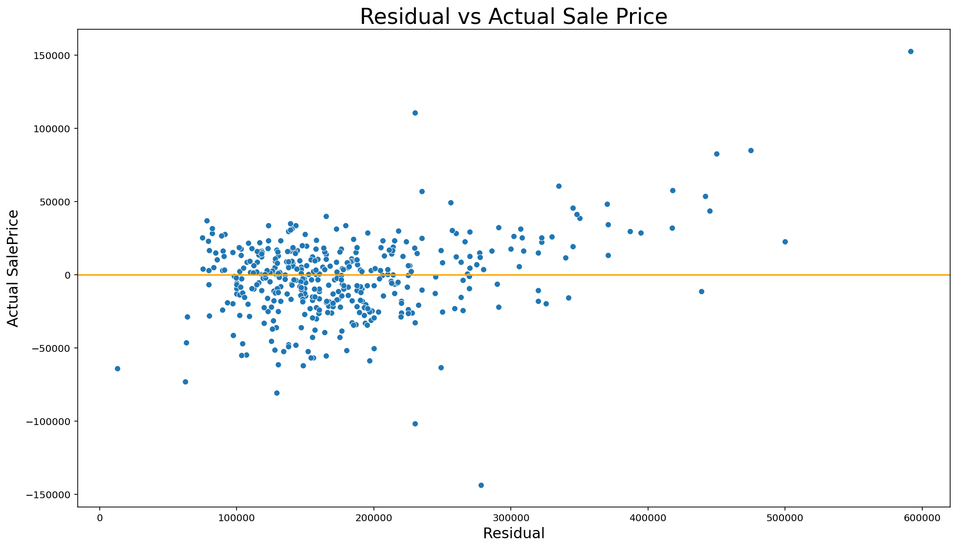
RESIDUAL PLOT

Slide 22
TOP PREDICTORS
TOTAL SQUARE FEET
OVERALL QUALITY
Above GROUND LIVING AREA
NEIGHBORHOOD

Slide 23
Further exploration
USING AUTOMATED FEATURE SELECTION
Use machine learning tools
Better imputation method
Study negative correlation

Slide 24
04
Conclusion & REcommendation

Slide 25
Conclusion
The total Sqft create the most impact on the selling prices of the houses, followed by the overall quality. It also appears that the neighborhood the house is in may give it a premium in terms of sales price. We can also see that Age of the house, quality of the houses' external material, the quality of the kitchen, garage area are less significant but still important
Overall, the factors that the models says have an impact on its sales price are within expectations of observable reality. The model though, does give us a better sense of how important each factor is with respect to another. Lasso seem to work better then ridge for this feature selection.

Slide 26
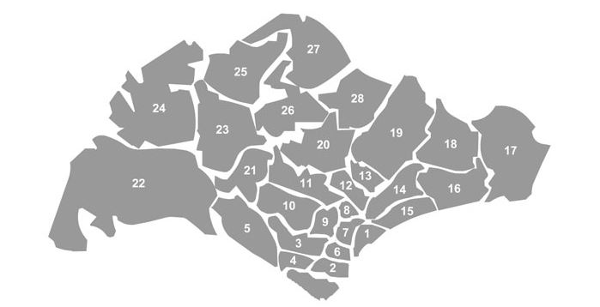
Future model
Grouping of the neighborhood into regions groups, the different district.
Further looking into the dataset and reduce more redundant features.
Looking deeper identify and remove the outliers.

Slide 27
thanks!
Do you have any questions?

